Slide 1
GRAMBOT
English Improvement Coach for Indian Accented Tones

Slide 2
DONE BY
Mohith Raagesh B - 21BCE1840

Slide 3
Introduction
This project centers around the development of a Voice Assistant dedicated specifically to enhancing public speaking skills. The aim is to create a device, app, or computer program that responds to commands or questions related to public speaking and facilitates specific tasks associated with improving one's speaking abilities. The primary goal is to design a Voice Assistant that not only assists the general user but also caters to the unique needs of individuals engaged in public speaking endeavors.The envisioned Voice Assistant is tailored to provide a hands-free experience for users, with a special emphasis on refining public speaking capabilities. Targeting the nuances of effective communication, the project focuses on creating a Personal Voice Assistant equipped with advanced deductive abilities.

Slide 4
Introduction (contd..)
This intelligent assistant interacts with users through the medium of human voice, capturing audio requests via a microphone and processing them using a sophisticated design methodology. The device then delivers responses through its in-built speaker module, facilitating an immersive and instructive experience for individuals dedicated to improving their public speaking skills.In essence, this project not only addresses the broader concept of Voice Assistants but hones in specifically on the realm of public speaking, aiming to empower users with a tool that enhances their communication prowess and overall effectiveness in public discourse

Slide 5
Literature Survey
The paper titled "An Assistive System for Visually Impaired using Raspberry Pi" introduces a novel combination of a reading machine (OCR) and a virtual assistant implemented on Raspberry Pi, offering significant utility for visually impaired individuals and those with disabilities. Optical Character Recognition (OCR) is employed to recognize and convert text into audio speech using GTTS (Google Text to Speech) through pre and post-processing. Google serves as the platform for the virtual assistant, facilitating daily tasks like checking emails, weather forecasts, and news, with additional integration of Google Assistant and Python enabling voice-based home automation. This project's overarching goal is to aid the visually impaired across various technological domains, allowing for tasks such as document reading, home automation, and personal assistant functions through simple voice commands.

Slide 6
Literature Survey (contd..)
In the paper Entitled “The art of public speaking: Machine learning and natural language processing to analyze TED talks” delves into the profound impact of TED talks, considering them as influential platforms disseminating ideas from expert speakers—a tradition rooted in the ancient art of speech. The study's objective lies in a meticulous examination and quantification of textual and descriptive factors pivotal to the triumph of TED talks. Utilizing data from TED talks and transcripts spanning 2006 to 2017, the paper defines success through view counts. Employing sentiment analysis, the research tracks a speaker's passion, and predictive elements are unearthed via regression, random forest, and XGBoost models. The analysis of 1,398 talks reveals that temporal attributes, storytelling, speaker charisma, and delivery speed emerge as the most influential factors, with weaker evidence for the impact of starting strong, presenting facts, and the speaker's passion. This study, grounded in machine learning, furnishes speakers with data-driven recommendations to enhance the structure, delivery, and tone of their presentations, offering insights into captivating audiences effectively.

Slide 7
Literature Survey(Contd..)
In the paper titled “Next-Generation of Virtual Personal Assistants (Microsoft Cortana, Apple Siri, Amazon Alexa and Google Home)” the author emphasizes the goal of achieving natural dialogue between humans and machines in the field of Artificial Intelligence (AI). The burgeoning area of interactive conversational systems within AI has led to the development of various Virtual Personal Assistants (VPAs) like Microsoft's Cortana, Apple's Siri, Amazon Alexa, Google Assistant, and Facebook's M. This proposal introduces a multi-modal dialogue system, capable of processing diverse user input modes such as speech, image, video, touch, gestures, gaze, and body movements. The Next Generation VPAs model enhances human-machine interaction through technologies like gesture recognition, image/video recognition, speech recognition, extensive dialogue knowledge bases, and general knowledge. This versatile VPAs system finds applications in education assistance, medical support, robotics, disability systems, home automation, and security access control. The experimental validation of this new VPAs model utilizes the IBM Watson cloud server with Python and Node Red.

Slide 8
Literature Survey (contd..)
In the paper entitled "Integrating Large Language Models into Higher Education: Guidelines for Effective Implementation," the complex process of potential large language model (LLM) integration is highlighted. This involves careful planning, strategic execution, and stakeholder engagement, necessitating the development of guidelines to support broad acceptance and elevate educational quality. These guidelines should be justified with specific implementation processes tailored for acceptance and quality outcomes. It's crucial to recognize that universities may choose not to allow LLMs, requiring alternative strategies for enhancing learning. If introduced, LLMs must align with higher education objectives, focusing on skills development.

Slide 9
Literature Survey(Contd..)
In the paper titled “Study of Voice Controlled Personal Assistant Device”the author underscores the significance of automation in the fast-paced technological landscape. To achieve seamless task automation, the need for a Personal Assistant with advanced deductive abilities and the capability to interact through human voice becomes apparent. The hardware device captures audio requests via a microphone, processing them to provide responses through an integrated speaker module. Another paper, "Efficient Large Vocabulary Speech Recognition on Mobile Devices," proposes a design utilizing a compact, accurate, and low-latency large vocabulary speech recognition system. This employs a CTC-based LSTM acoustic model, compressed to a tenth of its original size using SVD-based compression and quantization, ensuring real-time performance on smartphones.

Slide 10
Literature Survey (contd..)
In the paper titled "Voice Assistant Application for College Website," the author explores the transformative potential of technology in the contemporary era, emphasizing the need for platforms automating tasks. The focus is on applications like the Personal Voice Assistant, facilitating human interaction through voice commands. The proposed web application specifically targets a college website, altering the dynamics of user-website interactions. Designed to make all website services accessible through voice commands, this innovative system showcases the evolving capabilities of technology in enhancing user experience and ease of interaction.

Slide 11

Architecture

Slide 12
System Architecture of our voice Controlled Public Speaking tutor
The overall proposed system design consists of following phases:
1) Data Acquisition and Pre-processing
2) Model Training and Experimentation
3) Converting the speech to text for improvements
4) Providing a text to speech output of improved speech
5) Building the front End

Slide 13
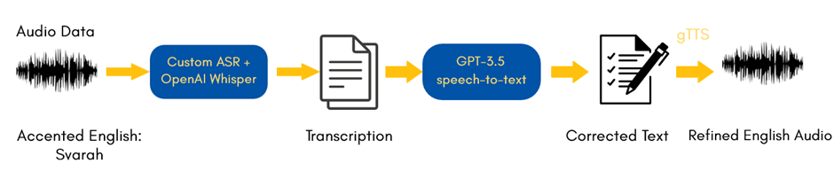
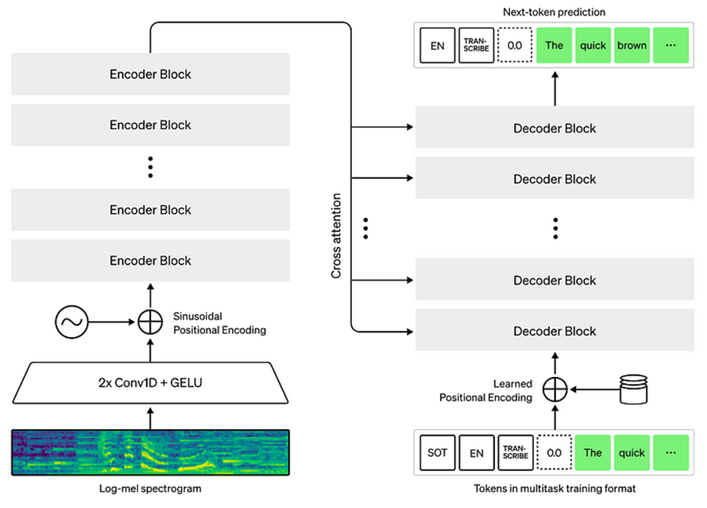
Whisper Model:

Slide 14

Conclusion

Slide 15
Conclusion
In conclusion, the development of a Public Speaking Voice Assistant, fortified by cutting-edge technology like the Whisper model, stands as a groundbreaking endeavor in refining communication skills. Specifically designed for diverse accents, this assistant employs advanced speech-to-text and text-to-speech models, along with a chat interface, for tailored English language coaching. The efficiency of the Whisper model is notably instrumental, not only in public speaking but also in translation services, contributing to a seamless and inclusive communication experience. The integration of multi-modal capabilities, encompassing gesture recognition and image/video processing, further enhances its adaptability and utility. As we anticipate the future, this innovative tool holds tremendous potential for revolutionizing education, fostering accessibility, and continually shaping the landscape of human-computer interaction.

